Slide 1
Design and Development of Online Health Assistance System
(ohas)

Slide 2
CONTENTS
INTRODUCTION
CONCEPT OF IOT
OBJECTIVES
BLOCK DIAGRAM
FLOW CHART
REQUIRED COMPONENTS
OVERVIEW OF ARDUINO
OVERVIEW OF ETHERNET SHIELD
OVERVIEW OF KG011 SENSOR
OVERVIEW OF DS18B20 SENSOR
HARDWARE
HTML PAGE WITH SENSOR DATA
FUTURE PROSPETCS
CONCLUSION
REFERENCES

Slide 3
INTRODUCTION
Health is one of the major important factor of human life. Everyone wants to be healthy and not to be affected by any disease. But somehow all we become affected by disease. In that situation we are left only one option that is, going to visit doctor. They are the only person who can do the necessary treatment to cure us. Often it happens that we become unable to get an appointment or we need instant suggestions from doctor. That is why, to reduce the difficulties of human life we are going to introduce a system that will help one to connect with the doctor very easily. Not only that, this system has the ability to measure the necessary vitals that are required for primary diagnostics. The basic prototype has the capability to measure heart rate and body temperature and display that information to the web page of one’s consultant doctor.

Slide 4
Concept of IoT
By the name one can easily define IoT as ‘Things’ which are connected to internet. Here ‘Things refer to the devices and everyday objects, from small ones (like wrist watch) to really big ones (like robots, cars). No matter what definition one may find about Internet of Things, the main concept behind every IoT technology and implementation is the same: devices are integrated with the virtual world of internet and interact with it by sensing and monitoring objects and their environment.

Slide 5
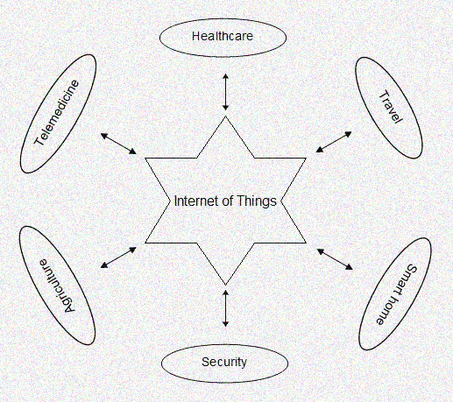
Concept of IoT

Slide 6
OBJECTIVES
The system will sense the human vitals through sensors
It will send the raw data to the CPU
The CPU will convert the raw data into human understandable form
The CPU will send these data along with the HTML code to the Ethernet Shield with an auto-refresh rate
Now the Ethernet Shield will send all (Data + HTML) to Internet or Router
The conversation box will to help in communication (text) between the doctor and client

Slide 7
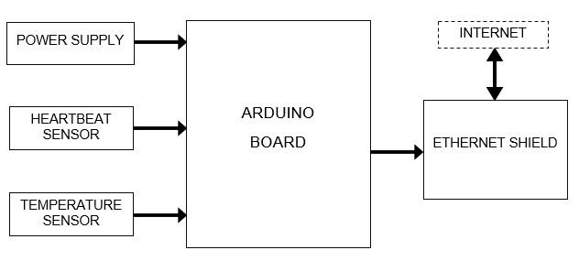
BLOCK DIAGRAM

Slide 8
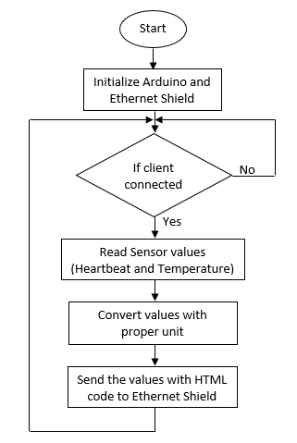
FLOW CHART

Slide 9
REQUIRED COMPONENTS
Arduino (ATmega 328p Microcontroller)
Ethernet Shield
Pulse Sensor (KG011)
Temperature Sensor (DS18B20)
Router
Power Supply

Slide 10
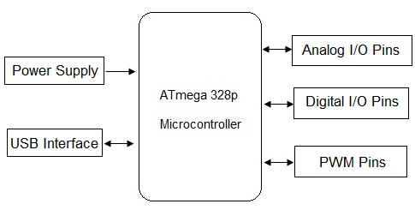
AN OVERVIEW OF ARDUINO
On board voltage regulator
Operating voltage is 5V
Operating frequency 16 MHz
14 digital I/O pins, of which
6 are PWM pins
6 ADC channel (10 bits)
32KB flash memory
(0.5KB for boot loader)
2 KB SRAM memory
1KB internal EEPROM
Programmable Serial USART
Master/Slave SPI Serial interface
I2C interface
Programmable watchdog timer with separate on-chip oscillator.

Slide 11
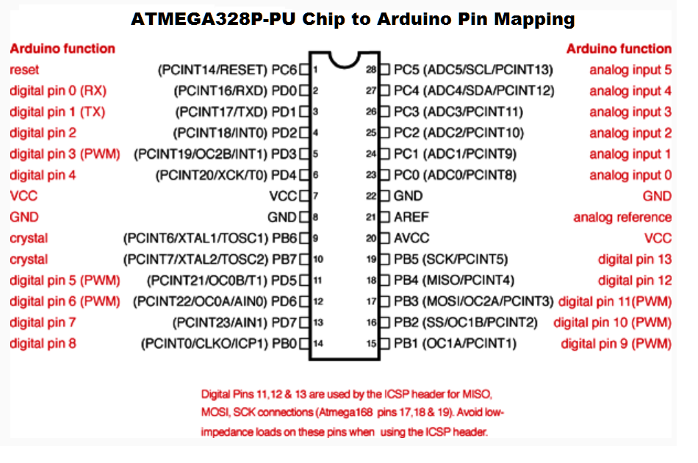
PIN DIAGRAM OF ATMEGA 328p μC

Slide 12
AN OVERVIEW OF ETHERNET SHIELD
It is based on the Wiznet W500 ethernet chip with 16K buffer
The Wiznet provides a network (IP) stack capable of both TCP and UDP
The shield has a standard RJ45 connector
It communicates with Arduino using the SPI bus
PWR: indicates that the board and shield are powered.
LINK: indicates the presence of network link and flashes when the shield transmits or receives data.
FULLD: indicates that the network is full duplex.
100M: indicates the presence of a 100 Mbps network connection (as opposed to 10 Mbps)
RX: flashes when the shield receives data
TX: flashes when the shield sends data
COLL: flashes when network collisions are detected

Slide 13
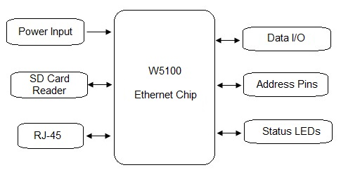
AN OVERVIEW OF ETHERNET SHIELD

Slide 14
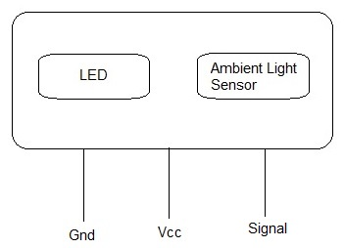
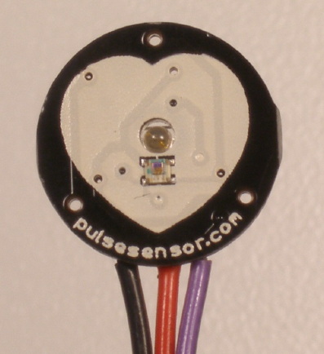
AN OVERVIEW OF KG011 SENSOR
The KG011 sensor is a pulse sensor and used to measure heartbeat rate
Two major components are there, an LED and an ambient light sensor
LED shines light into our skin which passes through capillary tissue and the sensor reads the light that bounces back
It has three connections Vcc, Gnd and Signal

Slide 15
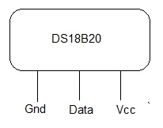
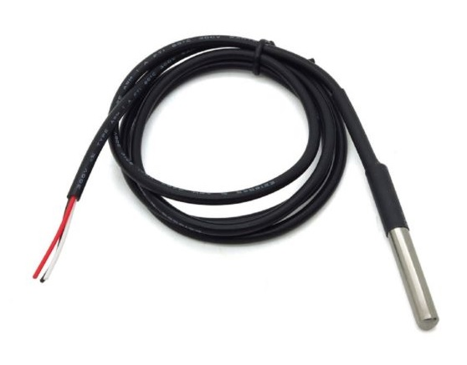
AN OVERVIEW OF DS18B20 SENSOR
The DS18B20 is a digital temperature sensor and mainly used as a thermometer
It can measure temperature in the range -55°C to +125°C
1-Wire bus for communication with CPU
The sensor has three pins; Vcc, Gnd and Data

Slide 16
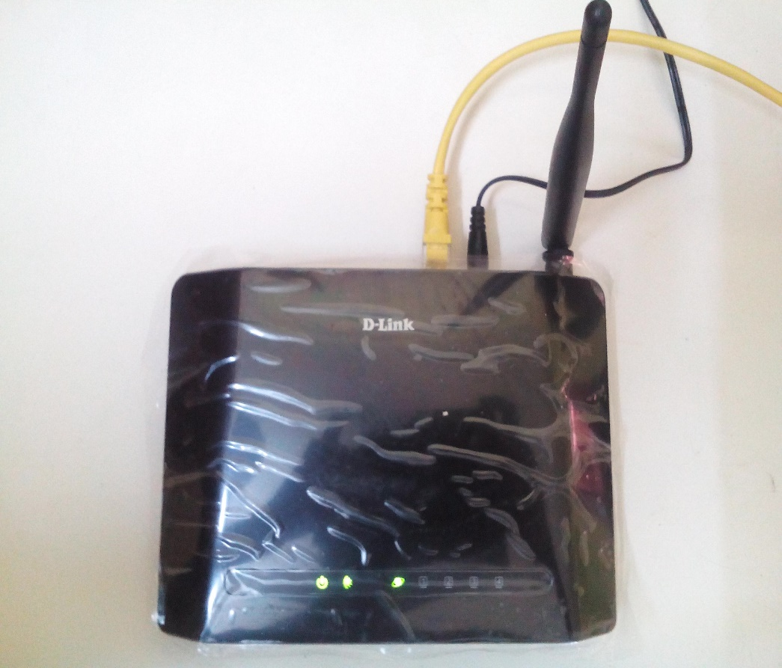
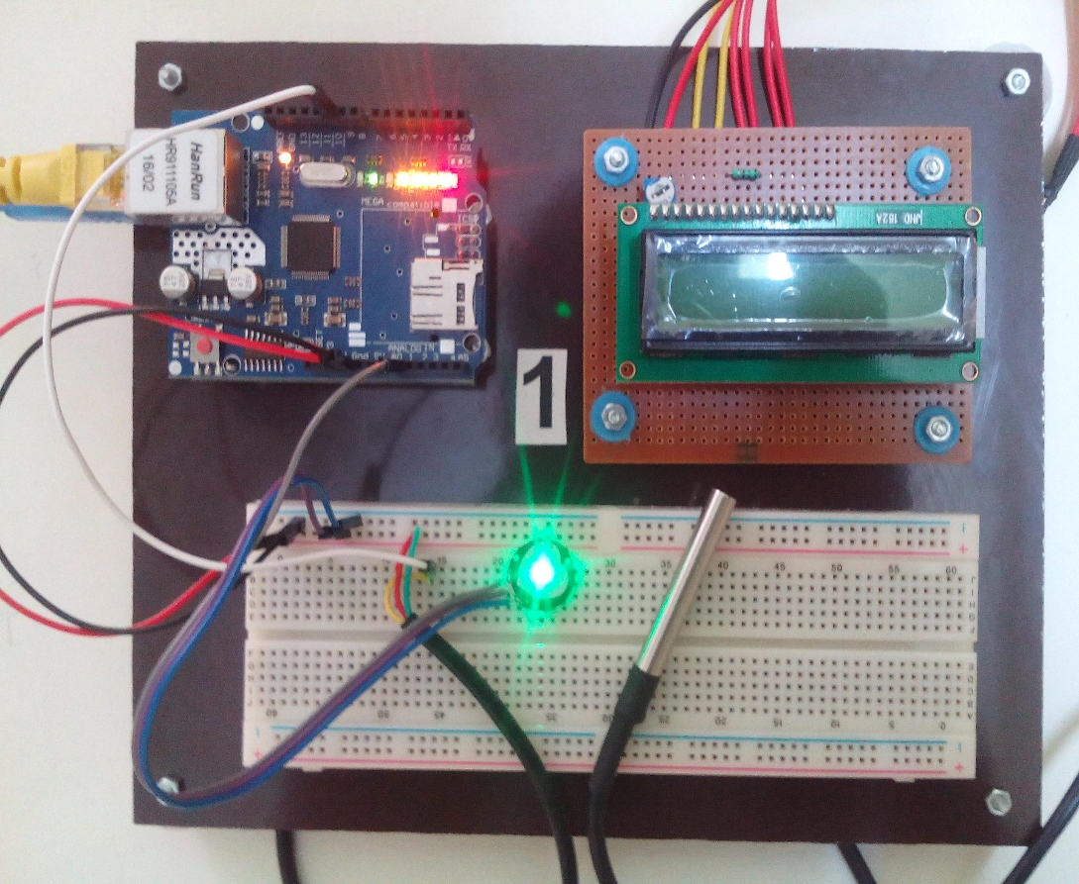
HARDWARE
Router
Arduino
With Shield
Pulse
Sensor
Temperature
Sensor with
probe

Slide 17
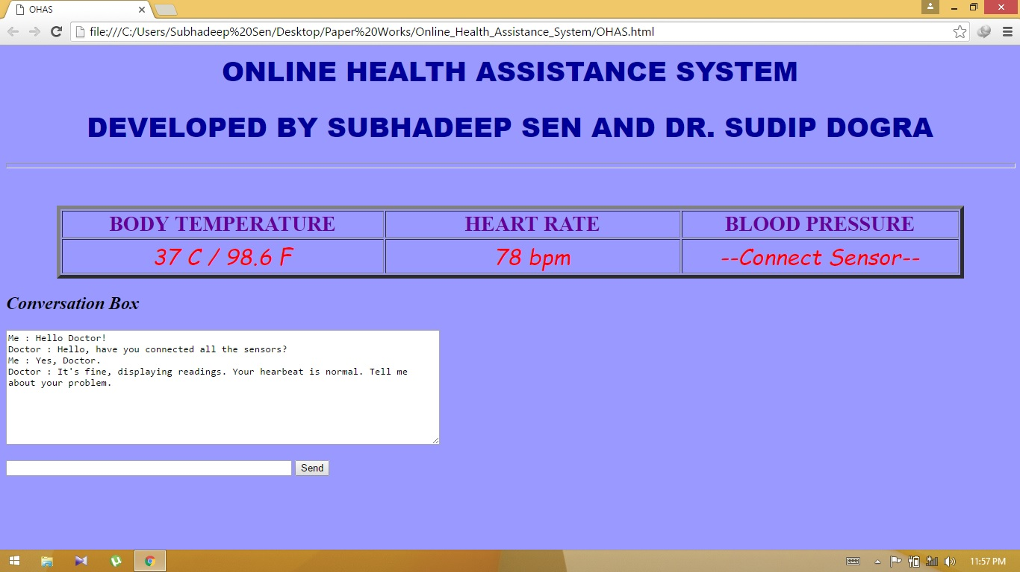
HTML PAGE WITH SENSOR DATA

Slide 18
FUTURE PROSPECTS
The system above shown is a very basic prototype. It can be further developed for the following facilities.
More sensors that are required for primary diagnostics.
Listing the available doctors with different categories.
Video conference facility.
Displaying proper graphs for Heartbeat, ECG, EEG etc. on the web page.
Making a small portable system with Wi-Fi facility.
And more other facilities can be included according to the needs.

Slide 19
CONCLUSION
Since this system provide immediate health assistance it can be very useful for human. One can easily consult with his doctor even without going to any medical center or from his home just by opening a browser tab. This will help a patient from the trouble of getting an appointment and also the time. Not only that, one who has the basic knowledge of treatment, he can easily monitoring those data and take immediate steps
Not only that, as the system keeps the scope of further development, it can be modified for different medical applications.

Slide 20
REFERENCES
Arduino:
https://en.wikipedia.org/wiki/ArduinoSIM900
Ethernet Shield:
https://www.arduino.cc/en/Main/ArduinoEthernetShield
KG011:
https://pulse-sensor.googlecode.com/files/PulseSensorAmped
GettingStartedGuide.pdf
DS18B20:
http://datasheets.maximintegrated.com/en/ds/DS18B20.pdf

Slide 21
THANK YOU

